Slide 1
BUILDING A TRUSTWORTHY INSURANCE INDUSTRY
Kobi Walker

Slide 2
ABSTRACT
This presentation explores ideas around the building of trust and confidence in member states of West African insurance companies Association with the focus on how insurers can build a trustworthy insurance industry.

Slide 3
ABSTRACT
The presentation aims to analyze the roles, responsibilities and image of WAICA, at a time when it is confronted with new challenges in the context of globalization, such as the fast pace of environmental devastation and degradation, the relentless advance of technological progress, which generate an ever-increasing number of implications in terms of risks and uncertainties

Slide 4
ABSTRACT
At first sight, one could estimate that WAICA enjoys a positive reputation in the public opinion, in so far as it significantly contributes to wealth creation, education and training in member states countries and communities bringing a number of positive contributions to society, which will be detailed in this presentation.

Slide 5
ABSTRACT
However, on closer inspection, it appears that the image of WAICA in the public opinion is not good – in reality, it appears to be blurred, if not squarely bad. Moreover, its reputation has been further tarnished by corporate scandals.

Slide 6
ABSTRACT
This presentation provides a brief overview of WAICA, continue with a brief analysis of the role WAICA plays in the economy of member states, the mandate of WAICA and conclude by reviewing the relationship amongst WAICA, customers and the general public with regards to trust and confidence in the insurance industry.

Slide 7
Outline
Introduction
Overview of the WAICA in the Insurance Industry
How can WAICA build a trustworthy Insurance Industry?
Charting the way forward
Closing

Slide 8
Introduction
The role of insurance in virtually all developed and developing nations cannot be overemphasized
WAICA has access to a burgeoning insurance industry in the region
Like most economic relationships, the industry is beset by a climate of distrust and suspicion
Our focus will be on how to generate and maintain trust, integrity, strength, ability, surety of the WAICA in the insurance industry

Slide 9
Overview/Role of WAICA
Regional body formed in 1973. Comprises insurance companies in English speaking west African countries. (Liberia, Sierra Leone, Ghana, Nigeria and The Gambia)
Risks cannot be lived without and have expressed the importance of insurance to be adopted at least, as a way out
Main objective is to foster a healthy growth and development of the insurance industry in the region
Key roles include: Education and training, Advocacy and networking, Facilitation of best practices and research and innovation
An important conduit for insurance growth and development in West Africa: Enhancement of insurance practices, overcoming industry challenges and promoting insurance awareness

Slide 10
Overview contd.
It is common knowledge that the insurance industry’s growth in WAICA region is hindered by many factors
Some of these factors include the low levels of income in the market space they operate under resulting in low priority ranking for insurance in their priorities in their scale of preferences.
The low purchasing power of the majority of citizens in the WAICA region is another factor especially during these financial challenging periods.
Most notably is the lack of awareness of the importance of being insured, basically due to bad education and a misperception of most citizens who believe that insurance companies do not pay claims when an emergency occurs.

Slide 11
Aims and objectives
The Founding Fathers at the birth of the Association set out the aims and objectives for the body.
Some of these have been achieved, some are on-going and others are no longer relevant.
The current list includes;

Slide 12
Aims and objectives
To encourage the exchange of information, data and experience among member companies
To encourage the exchange of business among member companies operating within Anglophone West Africa and beyond
To take reasonable steps aimed at reducing or eliminating economic waste arising from fires, accidents and other elemental causes.
To encourage the writing of books and articles on insurance in the region, that will enhance awareness of the impact and benefits insurance has in the socio-economic development of people.

Slide 13
Aims and objectives
To work with relevant stakeholders (International and Government Agencies and Private sector operatives) to achieve a harmonise insurance industry in West Africa and thereby creating a borderless sub-region
To encourage the development of the insurance market in each member country on sound and technical basis. Such development is inclusive of the developing of the insuring public from the economic and social angle.

Slide 14
Aims and objectives
To take any other necessary steps which are in the interest of members and which directly or indirectly have positive benefits on the lives of the communities within which members operate and promoting the objectives and aspirations of the Association.
To encourage the promotion of insurance education in each country and to encourage existing educational institutions such as universities to initiate courses and training programs on insurance and allied subjects as well as encouraging the exchange of business and personnel between companies.

Slide 15
How can WAICA build a trustworthy Insurance industry in the region?
It is becoming ever more evident that providing transparency in the insurance industry is vital for building and maintaining confidence and trust.
Although this has been discussed many times in recent years and improvements have been seen, there are still many ways that insurance providers can lead the way in trust when building relationships with their customers and the general public.
I will attempt to put forward possible solutions in managing trust issues in the industry

Slide 16
Do you Know?
In the insurance industry, establishing consumer trust is a significant challenge faced by every insurance agency. Surveys reveal alarmingly low levels of confidence, with only a mere 20% of customers believing that insurers are trustworthy and will honor claims.

Slide 17
Do you Know?
Additionally, 17% of U.S. consumers express a complete lack of trust in insurance companies. This lack of confidence stems from various factors, and one of the key reasons is the failure to humanize the customer experience.

Slide 18
Do you Know?
Building trust and confidence in the insurance industry can be quite challenging, especially in West Africa, but several insurance companies are working hard to make a difference.
Here are some suggestions on how to build trust in the Insurance industry in WAICA regions and beyond:

Slide 19
Building trust
Lack of understanding leads to distrust
The issue of transparency has always been somewhat of an ‘elephant in the room’ when associated with the insurance industry.
It comes as no surprise that for many years, this industry has been battling with developing trust among prospective and existing customers
From the customer perspective, the underlying reason why many individuals are distrusting of the insurance industry is due to a lack of insurance education.
If a customer doesn’t have a clear understanding of the policies and products that you are offering the issue of trust will continue to prevail

Slide 20
Building trust contd.
What Customers need regarding transparency
The term ‘insurance’ is essentially a promise to your customers that you will protect them in the event of a loss or an accident.
However, no promises can fully be made without understanding exactly what it entails.
Therefore when purchasing an insurance policy the qualifying questions involved need to be clear, written in plain language and transparent.
Without this, misunderstanding and confusion can occur.

Slide 21
Building trust contd.
A self-service seamless user experience
Consumers of today’s generation want a user experience that is accessible and easy to use.
When a consumer is buying an insurance product, they wish to have the same seamless experience that they receive when buying any other kind of product.
Most individuals now prefer a purchasing process that allows them to complete a transaction or fill out a form easily from their own smartphone or tablet devices without the need for human interaction

Slide 22
Building trust contd.
No jargon, hassle-free policy documents
Insurers need to make their documents more engaging in order to entice customers to read them.
It is no surprise that when individuals are presented with policy documents that contain small print and jargon-heavy language they are often put off reading them fully.
By making your policy documents easier to read without larger text, shorter sentences and more conversational and informative language there is a higher chance that a consumer will read it.
In a digitally obsessed world, it is also time that insurance providers start making documents available in a digital and mobile format so that they can be easily found and read online, or on their smartphone.

Slide 23
Building trust contd.
Honesty is an insurer’s best policy
Honesty truly is the best policy especially with regards to providing full information of the details of products, how products are priced and how claims and premiums are calculated
There have been instances in the past where customers have stated that insurance companies denied them valid claims, delayed claims, to intentionally confuse customers
Modern day customers want to have meaningful digital engagements and relationships with the companies that they interact with.
An insurance provider will have a much higher chance of achieving this if they can actively enter a customer relationship providing only truth, honesty and customer support.

Slide 24
Building trust contd.
Ensuring satisfaction for your customer
To provide satisfaction for your customers you need to provide them with an exceptional customer experience.
This can be achieved by listening to the needs of customers, simplifying their experiences online and offline, supporting them 24/7, empathizing with them and creating a cohesive journey.
Adopting and ensuring that you are completing all the above while providing honesty and transparency will undoubtedly impact the views that individuals have of the insurance industry.

Slide 25
Best proven practices?
Here are some best proven practices on how some insurance companies within WAICA regions are building trust in the Insurance industry in WAICA regions they operate

Slide 26
Building trust
Building trust and confidence in the insurance industry can be quite challenging, especially in West Africa, but several insurance companies are working hard to make a difference. Here are some examples:
This Nigeria-based company has managed to provide a personalized and hassle-free service to its customers.
They have an easy-to-navigate website and a responsive customer service that allows clients to know the status of their claims in real-time, thus building confidence in their operations.

Slide 27
Building trust
Building trust and confidence in the insurance industry can be quite challenging, especially in West Africa, but several insurance companies are working hard to make a difference. Here are some examples:
Africa Reinsurance Corporation provides a unique array of services by offering coverage based on individual client needs. Tailored packages and products have helped build the trust of consumers as they acknowledge the company's effort to put their needs first.

Slide 28
Building trust
Building trust and confidence in the insurance industry can be quite challenging, especially in West Africa, but several insurance companies are working hard to make a difference. Here are some examples:
Leadway Assurance Company: Leadway has made noticeable strides in improving customer experience in West Africa. By embracing digitization, they have made their services more accessible and efficient. Customers can easily purchase insurance, make claims, and communicate with the company online, which builds trust.

Slide 29
Building trust
Building trust and confidence in the insurance industry can be quite challenging, especially in West Africa, but several insurance companies are working hard to make a difference. Here are some examples:
Old Mutual has built trust with its vast clientele by providing transparent communication throughout their service provision. Clients are well informed of the policy terms, costs, and are updated promptly on any changes of their policies.

Slide 30
Building trust
Building trust and confidence in the insurance industry can be quite challenging, especially in West Africa, but several insurance companies are working hard to make a difference. Here are some examples:
NSIA Insurance known for their efficient and quick claim settlement, NSIA Insurance has managed to build a reputation of reliability and trust among its customers. This company is also leveraging technology to improve their turnaround times in claims processing.

Slide 31
Building trust
Building trust and confidence in the insurance industry can be quite challenging, especially in West Africa, but several insurance companies are working hard to make a difference. Here are some examples:
SUNU Assurance SUNU provides a comprehensive education platform that aids the clients in understanding complex insurance terms and selecting the best plans suitable for them. This helps build trust by empowering consumers to make informed decisions processing.

Slide 32
“ branding is the art of meaningful differentiation……..marketing just ensures we get there on time “
Sir Richard Branson
Chairman, Virgin Group

Slide 33
The Way Forward.
Solidify Trustworthiness
Listen – to your customers and act on their feedback
Culture – embed inclusivity and fairness; from IT development to customer services. Demand the same of partners
Educate – employees through effective training, and clients through ‘plain English’ contracts. Media and community engagements with specific targeted audiences for proper information dissemination.
Technology – to detect, develop and demonstrate trustworthiness e.g. through swift claims payments

Slide 34
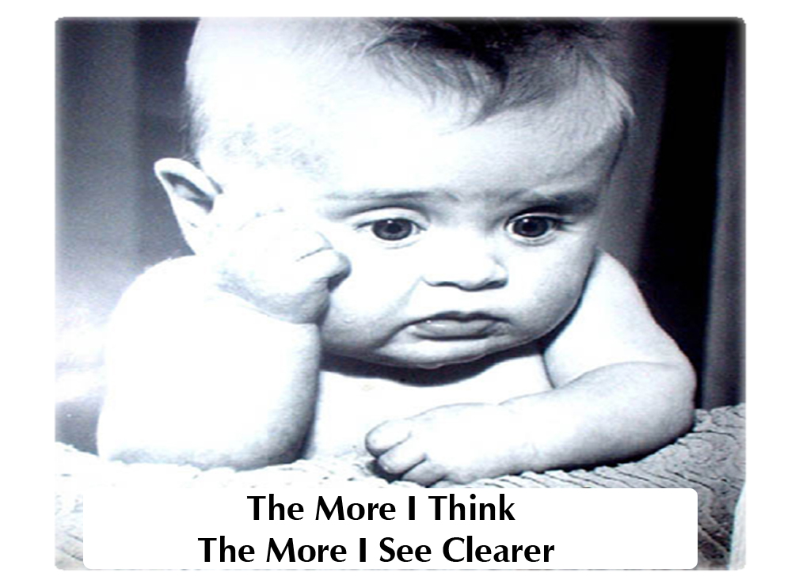

Slide 35
Closing: “ We regret to announce the death of……………. OPPORTUNITY!!!!

Slide 36
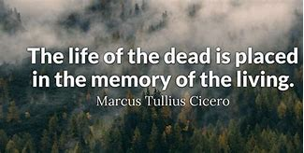
Closing: “ With gratitude to God for a life well spent………………” OPPORTUNITY!!!!

Slide 37
Industry growth imperatives

Slide 38
YOUR FEEDBACK
What should we do?
How do we do it?
What are the challenges?

