Slide 1





Aligning Insurance Practices in the 21st Century to Serve Public and Private Sectors
SPEAKER: Mr. Babatunde Fajemirokun, FCII, CEO AIICO Insurance Plc, Lagos, Nigeria.

Slide 2
The West African Insurance Market
A. Overview of the West African Insurance Market
Market size and growth trends
Regulatory environment and challenges
B. The Role of Insurance in Economic Development
Mitigating risk for businesses and individuals
Supporting investments and economic growth
C. Peculiarities of West African Macroeconomies
High volatility and economic instability
Informal sector dominance
Unique cultural and social factors

Slide 3
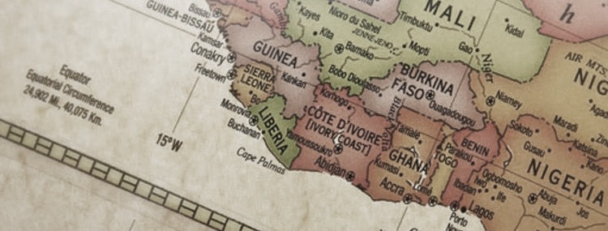
Overview of the West African Insurance Market
The West African insurance market has been experiencing notable changes in recent years, driven by evolving economic conditions, regulatory reforms, and shifting consumer preferences. Understanding the key aspects of this market is essential to aligning insurance practices effectively in the 21st century.

Slide 4
Overview of the West African Insurance Market
Market Size Growth Trends
01
Market Size
According to the Swiss Re Institute’s sigma 3/2023 report, the West African insurance market is still in its early stages of development, with a low insurance penetration rate of 0.6% in 2021. The report also highlights that the region has a large population and a growing middle class, which presents an opportunity for insurers to expand their reach and increase their market share. The market is diverse, with both life and non-life insurance segments contributing to its overall size.
Growth Trends
Despite challenges, the market has shown promise. Factors driving growth include rising awareness of insurance, increased urbanization, and a growing middle class with higher disposable incomes. Additionally, economic growth and infrastructure development have led to increased demand for insurance products
02

Slide 5
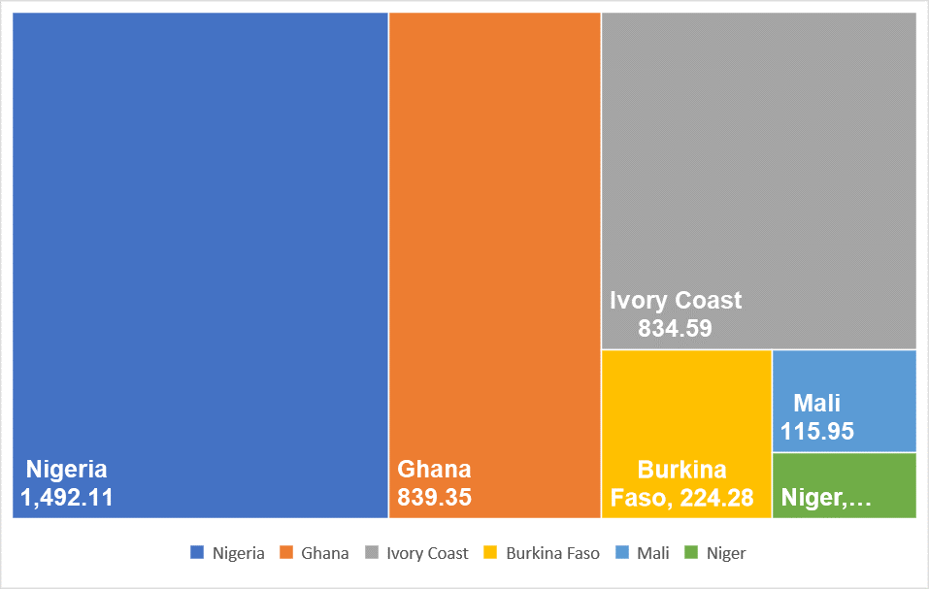






Overview of the West African Insurance Market
Market Size Growth Trends
03
Emerging Markets
Some West African countries are emerging as promising markets for insurance. For example, Nigeria, Ghana, and Côte d'Ivoire have demonstrated significant potential due to their large populations and expanding economies.

Slide 6
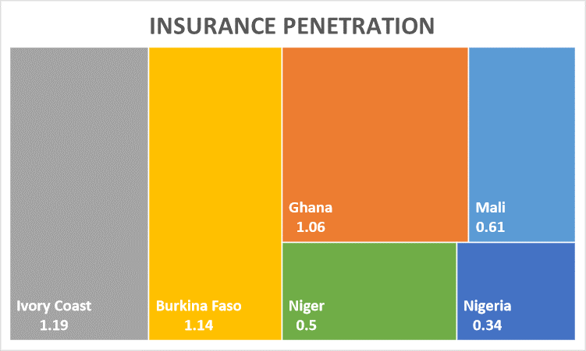
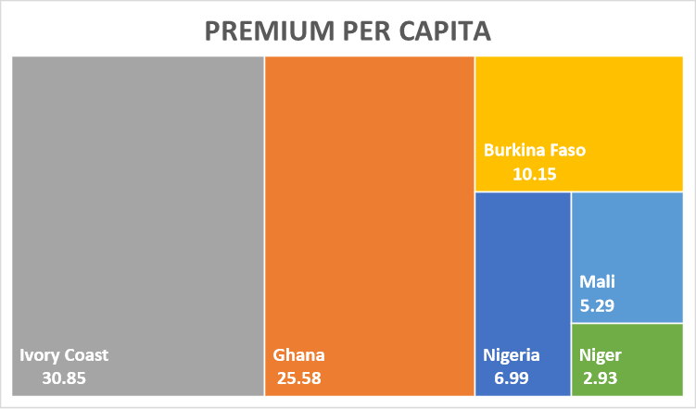
Overview of the West African Insurance Market

Slide 7
Overview of the West African Insurance Market
Regulatory Environment and Challenges
To align insurance practices effectively in West Africa, stakeholders must navigate the dynamic landscape of the insurance market, staying attuned to growth trends, advocating for regulatory improvements, and addressing unique regional challenges. The evolving nature of the market provides both opportunities and challenges that require thoughtful consideration and strategic planning.
Regulatory Framework
A
West African countries have varying regulatory frameworks governing the insurance industry. Harmonization efforts have been made through regional organizations like the West African Economic and Monetary Union (WAEMU) and the Economic Community of West African States (ECOWAS) to create more uniform regulations. However, challenges persist in aligning these regulations across the region.
Challenges in Regulatory Compliance
Insurance companies often face difficulties in complying with regulatory requirements, which can hinder market development. This includes issues related to capital requirements, solvency margins, and the need for improved corporate governance.
B
Consumer Protection
C
Ensuring consumer protection is a critical aspect of regulation. With many consumers having limited knowledge about insurance, there's a need for robust regulations that prevent predatory practices, ensure fair treatment of policyholders, and facilitate dispute resolution
Market Entry Barriers
D
The regulatory environment can present barriers to new entrants, limiting competition. Addressing these barriers can encourage innovation and help develop a more competitive market.
E
Cybersecurity and Data Privacy
In the 21st century, data protection and cybersecurity have become increasingly important. Regulatory frameworks need to adapt to address emerging risks related to the handling of sensitive customer information.

Slide 8
The Role of Insurance in Economic Development
Mitigating Risk for Businesses and Individuals
Insurance plays a pivotal role in fostering economic development in West Africa, with far-reaching implications for both businesses and individuals. Understanding and harnessing this role is vital to aligning insurance practices effectively in the 21st century.
01
Business Continuity
Insurance provides a safety net for businesses by mitigating various risks such as fire, theft, natural disasters, and liability claims. For small and medium-sized enterprises (SMEs), in particular, insurance can mean the difference between recovery and bankruptcy in the face of unexpected events.
Encouraging Entrepreneurship:
A robust insurance ecosystem encourages entrepreneurship and innovation by reducing the financial risks associated with starting and running a business. This is especially relevant in West Africa, where the informal sector often lacks access to formal financial safety nets.
02

Slide 9
The Role of Insurance in Economic Development
Mitigating Risk for Businesses and Individuals
Agricultural Sector:
03
Agriculture is a significant sector in many West African economies. Crop insurance, for instance, helps farmers manage the inherent risks associated with weather fluctuations, pests, and diseases. This stability encourages investment in agriculture, leading to increased food production and economic growth
Health Insurance:
04
Accessible health insurance helps individuals and families manage healthcare expenses. By reducing out-of-pocket healthcare costs, it can improve overall living standards and contribute to workforce productivity.

Slide 10
The Role of Insurance in Economic Development
Supporting Investments and Economic Growth
01
Infrastructure Development
Insuring infrastructure projects, such as roads, bridges, and energy facilities, provides investors and financiers with confidence that their investments are protected against unforeseen risks. This, in turn, attracts more infrastructure development, which is crucial for economic growth.
Foreign Direct Investment (FDI):
A well-developed insurance sector is often seen as a sign of economic stability. It can attract FDI by assuring foreign investors that their investments are safeguarded against risks. Increased FDI leads to capital inflow, job creation, and technology transfer.
02
Access to Capital
03
Insurance can act as collateral for loans and credit, enabling businesses and individuals to access financing more easily. This access to capital fosters investment in productive activities, which, in turn, spurs economic growth.
Innovation and Resilience
04
Insurers and reinsurers are increasingly involved in supporting innovative projects, particularly those related to climate change resilience. This aligns with the sustainable development goals of many West African nations and contributes to long-term economic stability..

Slide 11
The Role of Insurance in Economic Development
Supporting Investments and Economic Growth
To align insurance practices effectively in West Africa, policymakers, regulators, and industry stakeholders must recognize the profound impact that insurance can have on economic development. Encouraging insurance adoption, designing policies that support risk mitigation, and fostering a competitive insurance market are essential steps in realizing the full potential of insurance as a driver of economic growth in the region.

Slide 12
Peculiarities of West African Macroeconomies
High Volatility and Economic Instability
Commodity Dependency
Many West African economies are heavily dependent on commodities such as oil, minerals, and agricultural products. These commodities are susceptible to price fluctuations in the global market. Consequently, economic stability in the region is often threatened by external factors.
01
Currency Volatility
Exchange rate fluctuations are common, which can pose challenges for both businesses and insurers. Insurance policies may need to account for currency risk, and policyholders may face difficulties in receiving payouts in their desired currency.
02
Political Instability
03
West Africa has experienced periods of political instability, including coups, civil conflicts, and governance challenges. Such instability can disrupt economic activities and impact the insurance industry's ability to assess and underwrite risks effectively.

Slide 13
Peculiarities of West African Macroeconomies
Informal Sector Dominance
Limited Formalization
01
A significant portion of economic activity in West Africa takes place in the informal sector, which often operates outside formal insurance channels. Informal businesses and workers may not have access to insurance or may rely on traditional risk-sharing mechanisms.
Financial Exclusion
Many people in the informal sector lack access to formal financial services, including insurance. This poses a challenge for insurers seeking to expand their customer base and highlights the need for innovative distribution models tailored to the informal economy.
02
Informal Risk Management
03
Informal risk management practices, such as community-based mutual assistance schemes, are prevalent in West Africa. Understanding these practices and integrating them into insurance solutions can be beneficial in reaching underserved populations.

Slide 14
Peculiarities of West African Macroeconomies
Unique Cultural and Social Factors
Addressing these peculiarities requires a nuanced understanding of West African economies and societies. Insurance practitioners and policymakers must adapt their approaches to accommodate the high volatility, informal sector dominance, and unique cultural factors prevalent in the region. This may involve developing tailored insurance products, leveraging technology for outreach, and collaborating with community leaders to build trust and awareness about insurance's benefits. In doing so, the insurance industry can better serve the diverse and dynamic landscape of West Africa's macroeconomies.
Extended Families and Social Networks
01
In West African societies, extended families and social networks play a vital role in providing support during times of need. This cultural context influences individuals' perceptions of insurance and their willingness to participate in formal risk-sharing mechanisms.
Customary and Religious Practices
Customary and religious practices often have an impact on insurance decisions. For example, some communities may rely on spiritual beliefs to manage risks or may have reservations about certain insurance products.
02
Trust and Reputation
03
Trust is a critical factor in insurance. Building trust between insurers and customers is essential, particularly in societies where personal relationships and reputation carry significant weight.

Slide 15
Challenges in Aligning Insurance Practices
A. Low Insurance Penetration Rates
Identifying barriers to insurance adoption
B. Risk Assessment and Management
Assessing the unique risks in West Africa
C. Regulatory and Legal Framework
Addressing regulatory gaps

Slide 16
Low Insurance Penetration Rates
Identifying barriers to insurance adoption
Low insurance penetration rates are a persistent issue in West Africa, limiting the industry's ability to serve the public and private sectors effectively. Addressing these challenges is crucial for sustainable insurance growth in the region.
01
Lack of Awareness
One of the primary barriers to insurance adoption is the lack of awareness among the general population about the importance and benefits of insurance. Many people do not understand how insurance works or perceive it as an unnecessary expense.
Affordability
Insurance premiums can be perceived as unaffordable, particularly in low-income segments of the population. People may prioritize immediate needs over insurance coverage, such as healthcare, education, and housing.
02
Complexity of Products
03
Insurance products are often complex and may not be well-suited to the needs and preferences of the local population. Simplifying product offerings and improving transparency can make insurance more accessible.

Slide 17
Low Insurance Penetration Rates
Identifying barriers to insurance adoption
Trust Issues
04
Trust is a significant factor in insurance. People may distrust insurers, fearing that they will not receive fair compensation when filing a claim. This is especially common in regions with a history of fraudulent practices.
By addressing the barriers to insurance adoption and implementing targeted strategies to increase awareness and accessibility, the insurance industry can make significant strides in aligning practices to serve both the public and private sectors. These efforts have the potential to foster economic stability and resilience in the face of the region's unique challenges.

Slide 18
Risk Assessment and Management
Assessing the Unique Risks in West Africa
Risk assessment and management are essential components of the insurance industry, but they come with unique challenges in the context of West Africa:
01
Climate-Related Risks
West Africa is vulnerable to climate change, experiencing challenges such as droughts, floods, and erratic rainfall. Insurers must adapt to these evolving risks, offering coverage for climate-related damages to agriculture, property, and infrastructure.
Political and Social Instability
Political instability, civil unrest, and social tensions are risks that can disrupt business operations. Insurers need to factor in these uncertainties when underwriting policies for businesses and investments in the region.
02

Slide 19
Risk Assessment and Management
Assessing the Unique Risks in West Africa
Health Epidemics
03
West Africa has experienced outbreaks of diseases such as Ebola and, more recently, COVID-19. The insurance industry must develop solutions that respond to the health risks posed by infectious diseases, including coverage for business interruption.
Infrastructure Challenges
04
Inadequate infrastructure in some areas can lead to risks such as supply chain disruptions and property damage. These risks should be assessed and addressed when designing insurance products for businesses in these regions.
Effective risk assessment and management are critical for the insurance industry to align with the unique challenges and opportunities presented by West Africa's macroeconomies. Innovations in data analytics, technology, product design, and collaboration can help insurers address these challenges while providing valuable coverage to businesses and individuals in the region. By proactively managing risks, insurers can contribute to economic stability and resilience in West Africa.

Slide 20
Regulatory and Legal Framework
Addressing Regulatory Gaps
The regulatory and legal framework plays a crucial role in shaping the insurance industry in West Africa. However, there are several challenges that need to be addressed to effectively align insurance practices in the region:
Inconsistent Regulations
01
One significant challenge is the inconsistency of insurance regulations across West African countries. While regional organizations like ECOWAS and WAEMU have made efforts to harmonize regulations, disparities persist. These inconsistencies can hinder cross-border operations and market development.
Lack of Supervisory Capacity
Some regulatory bodies in the region may lack the capacity and resources needed to effectively supervise and regulate the insurance sector. This can result in inadequate oversight and enforcement of regulations.
02
Regulatory Fragmentation
03
The presence of multiple regulatory bodies overseeing different aspects of the insurance industry can lead to fragmentation and inefficiency. A more streamlined and unified regulatory approach could enhance transparency and accountability.

Slide 21
Regulatory and Legal Framework
By addressing regulatory gaps and fostering cooperation between the public and private sectors, West African countries can create a regulatory environment that is conducive to the growth and alignment of insurance practices. This collaborative approach can help unlock the potential of the insurance sector to serve both the public and private sectors effectively while promoting economic stability and resilience in the region.

Slide 22
Opportunities for Alignment
A. Leveraging Technology
Insurtech solutions for increased efficiency
Mobile-based insurance products for wider reach
B. Public-Private Partnerships
Collaborative efforts in risk mitigation
Sharing best practices and data
C. Customized Insurance Products
Tailoring policies to West African needs
Microinsurance and agricultural insurance

Slide 23
Opportunities for Alignment
Leveraging Technology
In the 21st century, technology is a game-changer for the insurance industry in West Africa, offering opportunities for increased efficiency and broader accessibility to insurance products. Here are some key aspects to consider:

Slide 24
Leveraging Technology
Insurtech Solutions for Increased Efficiency
01
Digital Underwriting and Risk Assessment
Insurtech solutions can streamline the underwriting process by automating risk assessment. Data analytics, artificial intelligence (AI), and machine learning algorithms can evaluate risks more accurately and quickly than traditional methods, enabling insurers to price policies competitively.
Claims Processing
Insurtech can expedite claims processing through digital claims submission, automated verification, and quicker payouts. This enhances customer satisfaction and trust in the insurance industry.
02
Fraud Detection
03
Advanced analytics can help insurers detect fraudulent claims more effectively. This not only reduces the financial impact of fraud but also contributes to lower premiums for policyholders.
Customer Engagement
04
Insurtech platforms can enhance customer engagement by offering self-service portals, chatbots, and mobile apps. These tools empower policyholders to manage their policies, access information, and receive personalized recommendations.

Slide 25
Leveraging Technology
Insurtech Solutions for Increased Efficiency
05
Telematics and IoT
Insurers can leverage telematics and the Internet of Things (IoT) to monitor and reward safe driving behaviors. This is particularly relevant for auto insurance and can contribute to reduced accident rates.
Blockchain for Transparency
Blockchain technology can enhance transparency and trust in insurance transactions. Smart contracts can automate policy execution, reducing the risk of disputes.
06

Slide 26
Leveraging Technology
Mobile-Based Insurance Products for Wider Reach
01
Mobile Payment Solutions
Many West Africans have access to mobile phones but limited access to traditional banking services. Mobile payment solutions can enable convenient premium payments, making insurance more accessible to a broader population.
Microinsurance via Mobile
Mobile technology facilitates the distribution of microinsurance products. Insurers can offer low-cost insurance options that cater to the needs of underserved populations, such as smallholder farmers and low-income individuals.
02
Text-Based Insurance Information
03
SMS-based services can be used to provide insurance information, including policy details, renewal reminders, and emergency contact numbers. This can improve policyholder engagement.
Digital Aggregators
04
Collaborate with digital aggregators and online marketplaces to expand the reach of insurance products. These platforms can provide a one-stop shop for consumers to compare and purchase policies.

Slide 27
Leveraging Technology
Mobile-Based Insurance Products for Wider Reach
05
Data Collection and Analysis
Mobile data can be harnessed for better risk assessment. For example, data on weather conditions, agricultural practices, and health metrics collected via mobile apps can inform the design of specialized insurance products.
Education and Awareness
Mobile apps and text messages can be used for educational campaigns, increasing awareness about the benefits of insurance and promoting financial literacy.
06
Leveraging technology in these ways presents a significant opportunity to enhance insurance practices in West Africa. It allows insurers to overcome geographical and infrastructural challenges, expand their customer base, and provide more efficient services. However, it's essential that technology adoption is accompanied by measures to address digital literacy, data privacy, and cybersecurity to ensure the sustainable growth of the insurance industry in the region.

Slide 28
Public-Private Partnerships
Collaborative Efforts in Risk Mitigation
Public-private partnerships (PPPs) offers a dynamic platform for synergy between government agencies, insurance companies, and other stakeholders. These partnerships can be instrumental in addressing challenges and leveraging opportunities in the West African insurance sector. Here are some key aspects to consider:
Disaster Preparedness and Response
01
Governments and insurance companies can collaborate to develop disaster preparedness and response strategies. Insurers can offer expertise in risk modeling and assessment, while governments can provide resources and infrastructure for disaster relief efforts.
Agricultural Risk Mitigation
Given the significance of agriculture in many West African economies, public-private partnerships can be forged to develop insurance solutions tailored to the agricultural sector. These solutions can include weather-indexed insurance, which pays out based on predetermined weather conditions.
02
Infrastructure Protection
03
Infrastructure development is a key driver of economic growth. Public-private partnerships can focus on protecting infrastructure investments through insurance against risks such as natural disasters, political instability, and construction delays.

Slide 29
Public-Private Partnerships
Collaborative Efforts in Risk Mitigation
05
Pandemic Preparedness
The experience of the COVID-19 pandemic highlights the need for collaborative efforts to prepare for health-related risks. Governments and insurers can work together to design insurance products that cover business interruption due to pandemics and support healthcare facilities.
Data Sharing
Governments can provide access to relevant data, including historical disaster data and weather information, to help insurers improve risk assessment and pricing accuracy. In return, insurers can share data on emerging risks and loss experiences.
06

Slide 30
Public-Private Partnerships
Sharing Best Practices and Data
01
Regulatory Best Practices
Public-private partnerships can facilitate the sharing of best regulatory practices. This can help streamline regulations, create a conducive regulatory environment, and harmonize standards across countries in the region.
Capacity Building
Collaborative efforts can include capacity-building programs aimed at training insurance professionals, regulators, and government officials. This helps strengthen the expertise needed to effectively manage the insurance sector.
02
Data Sharing for Risk Modeling
03
Insurance companies can collaborate with governments to access and analyze data for risk modeling. This can lead to more accurate risk assessments and better-informed underwriting decisions.
Fraud Detection
04
Sharing data related to fraudulent activities can help insurers and law enforcement agencies detect and prevent insurance fraud more effectively, reducing losses and protecting policyholders.

Slide 31
Public-Private Partnerships
Sharing Best Practices and Data
05
Customer Insights
Public-private partnerships can enable the sharing of customer insights and feedback, allowing insurers to tailor their products and services to the specific needs and preferences of the West African population.

Slide 32
Public-Private Partnerships
Education and Awareness Campaigns
Joint Awareness Campaigns
01
Government agencies and insurers can jointly launch awareness campaigns to educate the public about the importance of insurance and risk management. These campaigns can use various mediums, including television, radio, social media, and community events.
Financial Literacy Programs
Collaborative efforts can extend to financial literacy programs that teach individuals and businesses how insurance can be an essential part of their financial planning and risk mitigation strategies.
02
Public-private partnerships are a powerful tool for aligning insurance practices in West Africa. By combining the resources, expertise, and reach of both sectors, these partnerships can drive innovation, expand access to insurance, and enhance the resilience of individuals and businesses in the face of economic and environmental challenges. It's essential that these partnerships are guided by clear objectives, transparency, and a commitment to the long-term development of the insurance industry in the region.

Slide 33
Customized Insurance Products
Tailoring Policies to West African Needs
Customized insurance products are a powerful tool for increasing insurance adoption and aligning insurance practices with the unique needs of West Africa. Here's an in-depth look at this opportunity:
Tailoring Policies to West African Needs
01
Local Risk Assessment: Insurers can employ localized risk assessment techniques to understand the specific challenges faced by West African policyholders. This includes considering factors such as climate, agriculture, infrastructure, and health issues that are prevalent in the region.
Flexible Coverage
Offering flexible coverage options that allow policyholders to customize their insurance policies based on their unique requirements. This adaptability can make insurance more attractive and relevant to the diverse West African population.
02
Affordable Premiums
03
Recognizing the economic constraints faced by many in the region, insurers can design insurance products with affordable premiums that align with the income levels of the target market. This can be especially beneficial for micro, small, and medium-sized enterprises (MSMEs) and low-income individuals.

Slide 34
Customized Insurance Products
Tailoring Policies to West African Needs
04
Multi-Peril Insurance
Developing insurance products that cover multiple risks simultaneously, such as a combination of crop insurance, property insurance, and liability insurance, can provide comprehensive protection against a range of threats, reducing the need for multiple policies.
Community-Based Insurance
05
Designing insurance products that cater to the communal nature of many West African societies. Community-based insurance schemes can foster trust and enable shared risk management among neighbors and community members.

Slide 35
Customized Insurance Products
Microinsurance
01
Tailored Coverage for Low-Income Individuals
Microinsurance offers insurance products designed specifically for low-income individuals and informal sector workers. These policies cover risks that are most relevant to this demographic, such as health, disability, and funeral expenses.
Affordable Premiums
Microinsurance products are typically characterized by low premiums, making them accessible to individuals with limited financial resources. This affordability encourages adoption among those who would otherwise remain uninsured.
02
Simplified Claims Processes
03
Microinsurance providers often employ simplified and user-friendly claims processes, reducing administrative burdens and ensuring policyholders can easily access benefits when needed.
Partnerships with Microfinance Institutions
04
Collaborations with microfinance institutions can facilitate the distribution of microinsurance products, as these institutions often have extensive networks in rural and low-income areas.

Slide 36
Customized Insurance Products
Agricultural Insurance
01
Protecting Farmers
Agriculture is a critical sector in many West African economies. Agricultural insurance products can protect farmers against crop failure due to adverse weather conditions, pests, or diseases, helping to stabilize their livelihoods.
Index-Based Insurance
Leveraging technology and weather data, insurers can offer index-based insurance products that automatically trigger payouts when specific weather conditions (such as drought or excessive rainfall) are met. This eliminates the need for time-consuming claims assessments.
02
Risk Management Services
03
Alongside insurance coverage, insurers can provide risk management services to farmers, such as agronomic advice, weather forecasting, and access to improved farming practices.
Government Support
04
Collaborations between insurers and governments can lead to subsidized agricultural insurance programs that make coverage more affordable for smallholder farmers. These partnerships can also involve risk-sharing mechanisms.

Slide 37
Customized Insurance Products
Customized insurance products, including microinsurance and agricultural insurance, are instrumental in addressing the unique needs and challenges faced by West Africa. These tailored offerings can increase insurance adoption, improve financial resilience, and support economic growth in the region. It's essential for insurers to work closely with local communities, governments, and other stakeholders to design and deliver these products effectively.

Slide 38
Strategies for Effective Alignment
A. Education and Awareness Campaigns
Promoting financial literacy and insurance awareness
Role of educational institutions and industry associations
B. Strengthening Regulatory Oversight
Implementing sound regulatory policies
Encouraging transparency and accountability
International Best Practices
C. Research and Data Analytics
Leveraging data for informed decision-making
Identifying emerging risks and market trends
Risk Mitigation and Product Development

Slide 39
Education and Awareness Campaigns
Promoting Financial Literacy and Insurance Awareness
Education and awareness campaigns play a pivotal role in promoting financial literacy, increasing insurance awareness, and aligning insurance practices with the needs of West Africa. Here's a detailed look at these strategies:
Targeted Messaging
01
Campaigns should use culturally relevant and relatable messaging to resonate with the local population. They should explain insurance concepts in simple terms and emphasize the real-life benefits of insurance in mitigating risks.
Multimedia Approach
Employ a variety of media channels to reach a broad audience. This includes television, radio, social media, print materials, and community outreach programs. Leveraging local languages can enhance accessibility.
02
Case Studies and Success Stories
03
Sharing real-life examples of how insurance has benefited individuals and businesses in West Africa can help demystify insurance and inspire trust.

Slide 40
Education and Awareness Campaigns
Promoting Financial Literacy and Insurance Awareness
04
Interactive Workshops and Webinars
Organize workshops and webinars on financial literacy and insurance topics. These events provide opportunities for participants to ask questions and engage with experts.
Collaborations with Influencers
05
Partner with local influencers, celebrities, and community leaders to endorse insurance and financial literacy messages. Their endorsements can carry significant weight in local communities.

Slide 41
Education and Awareness Campaigns
Role of Educational Institutions
01
Integration into Curriculum
Collaborate with educational institutions, including schools and universities, to integrate financial literacy and insurance education into the curriculum. This ensures that young people are exposed to these concepts early on.
Scholarships and Competitions
Create incentives for students to learn about insurance by offering scholarships or organizing insurance-related competitions. This encourages students to explore the field and consider careers in insurance.
02
Financial Literacy Programs
03
Educational institutions can partner with insurance industry associations and regulators to offer financial literacy programs that go beyond the classroom. These programs can include internships, industry visits, and mentoring opportunities.
Research and Publications
04
Encourage research and publications on insurance-related topics within educational institutions. This can contribute to the development of academic expertise in insurance and risk management.

Slide 42
Education and Awareness Campaigns
Role of Industry Associations
01
Advocacy and Policy Engagement
Industry associations can advocate for policies that support financial literacy and insurance awareness. They can engage with regulators and policymakers to shape a favorable regulatory environment.
Public Awareness Campaigns
Collaborate with insurers and other stakeholders to launch public awareness campaigns. Industry associations often have the resources and expertise to drive large-scale initiatives.
02
Training and Certification
03
Offer training programs and certification courses for insurance professionals. This ensures that the industry has a skilled workforce capable of delivering quality insurance products and services.

Slide 43
Education and Awareness Campaigns
Role of Industry Associations
04
Data Sharing
Industry associations can facilitate the sharing of data and best practices among member companies. This can help identify successful strategies for increasing insurance penetration and awareness.
Research and Publications
Publish industry reports and research findings that highlight the economic and social benefits of insurance. These publications can be valuable resources for policymakers and educators.
05
In conclusion, education and awareness campaigns are integral to aligning insurance practices in West Africa with the needs of the population. The involvement of educational institutions and industry associations is essential for the long-term success of these campaigns. By working together and leveraging their resources and expertise, these stakeholders can significantly enhance financial literacy, improve insurance awareness, and foster a more resilient and protected society in the region.

Slide 44
Strengthening Regulatory Oversight
Implementing Sound Regulatory Policies
Strengthening regulatory oversight is fundamental to ensuring the integrity, stability, and growth of the insurance industry in West Africa. Here's a detailed look at these strategies:
Harmonization of Regulations
01
Promote efforts to harmonize insurance regulations across West African countries. Regional organizations such as ECOWAS and WAEMU can play a crucial role in standardizing regulations, which reduces barriers to cross-border operations and fosters regional growth.
Risk-Based Supervision
Adopt risk-based supervision approaches that focus regulatory resources on insurers with higher risk profiles. This ensures that regulatory efforts are efficient and targeted, safeguarding policyholders' interests
02
Consumer Protection Regulations
03
Develop and enforce consumer protection regulations to ensure that insurers treat policyholders fairly. These regulations can include rules on claims handling, dispute resolution mechanisms, and disclosure requirements.

Slide 45
Strengthening Regulatory Oversight
Implementing Sound Regulatory Policies
04
Solvency Requirements
Set appropriate solvency requirements that ensure insurers maintain sufficient capital to cover their liabilities. Regular assessments and stress testing can help regulators gauge the financial health of insurance companies.
Market Entry and Exit Requirements
05
Establish clear and transparent criteria for insurers to enter and exit the market. This prevents unqualified insurers from operating and facilitates a level playing field for all participants.

Slide 46
Strengthening Regulatory Oversight
Encouraging Transparency and Accountability
01
Financial Reporting Standards
Mandate the use of internationally recognized financial reporting standards, such as International Financial Reporting Standards (IFRS), to enhance transparency in financial reporting by insurance companies.
Market Conduct Oversight
Strengthen market conduct oversight to ensure that insurers treat customers fairly and ethically. This includes monitoring sales practices, product suitability, and fair pricing.
02
Complaints Resolution Mechanisms
03
Establish efficient and accessible complaints resolution mechanisms that allow policyholders to seek redress in case of disputes with insurers. Timely resolution of complaints enhances trust in the industry.
Anti-Fraud Measures
04
Implement anti-fraud measures to detect and prevent fraudulent activities within the insurance sector. Collaboration with law enforcement agencies can help prosecute individuals involved in fraudulent schemes.

Slide 47
Strengthening Regulatory Oversight
Encouraging Transparency and Accountability
05
Market Surveillance
Conduct regular market surveillance to identify and address emerging risks, market misconduct, and trends that may affect policyholders or market stability.
Public Reporting
Encourage insurance companies to publicly disclose information about their financial performance, corporate governance practices, and compliance with regulatory requirements. This fosters accountability and enables stakeholders to make informed decisions.
06
Capacity Building
07
Invest in the capacity building of regulatory bodies to equip them with the necessary skills and expertise to oversee the insurance industry effectively. Training programs and international collaborations can be beneficial in this regard.

Slide 48
Strengthening Regulatory Oversight
International Best Practices
01
Benchmarking
Benchmark regulatory practices against international best practices and standards. Regular assessments can identify areas for improvement and align West African regulations with global norms.
Collaboration with International Bodies
Collaborate with international bodies, such as the International Association of Insurance Supervisors (IAIS), to access resources, expertise, and best practices in insurance regulation.
02
Peer Reviews
03
Engage in peer reviews with other countries and regions to exchange experiences and identify areas where regulatory alignment and cooperation can be enhanced.

Slide 49
Strengthening Regulatory Oversight
International Best Practices
04
Cross-Border Regulation
Develop frameworks for cross-border insurance supervision and coordination, particularly for insurers operating in multiple West African countries. This ensures that regulatory standards are upheld across borders.
Strengthening regulatory oversight is essential to ensuring the stability and growth of the insurance industry in West Africa. It enhances consumer confidence, attracts investment, and facilitates the alignment of insurance practices with international standards. By implementing sound regulatory policies and promoting transparency and accountability, West African nations can build a robust and resilient insurance sector that serves both public and private sectors effectively.

Slide 50
Research and Data Analytics
Leveraging Data for Informed Decision-Making
Research and data analytics are pivotal components for the evolution and alignment of insurance practices in West Africa. They provide the foundation for informed decision-making, risk assessment, and identifying emerging trends and risks. Here's a comprehensive look at these strategies:
Data Collection
01
Establish robust mechanisms for data collection within the insurance industry. This includes gathering data on policyholders, claims, underwriting, and market dynamics. Data collection should be comprehensive, accurate, and up-to-date.
Data Quality
Ensure the quality and reliability of data through rigorous validation and cleansing processes. Accurate data is essential for making informed decisions and risk assessments.
02
Data Integration
03
Integrate data from various sources, including government agencies, industry associations, and external data providers. A holistic view of data can reveal comprehensive insights into market trends and customer behaviors.

Slide 51
Research and Data Analytics
Leveraging Data for Informed Decision-Making
04
Advanced Analytics
Employ advanced analytics techniques, such as predictive modeling and machine learning, to extract actionable insights from data. These techniques can help insurers make more accurate risk assessments, optimize pricing, and improve underwriting processes.
Customer Insights
05
Analyze customer data to gain a deeper understanding of customer preferences, needs, and behaviors. This enables insurers to tailor products and services to specific customer segments.
Claims Analytics
06
Use data analytics to assess claims patterns and detect anomalies or potential fraud. This not only reduces financial losses but also enhances customer trust in the claims process.

Slide 52
Research and Data Analytics
Identifying Emerging Risks and Market Trends
01
Early Warning Systems
Develop early warning systems that can identify emerging risks in West African markets. These systems can include monitoring economic indicators, political stability, climate patterns, and other factors that may impact the insurance industry.
Climate Risk Assessment
02
Given the region's vulnerability to climate change, insurers should conduct thorough climate risk assessments. These assessments can inform the development of climate-resilient insurance products and underwriting criteria.
Market Trend Analysis
03
Regularly analyze market trends, including shifts in consumer preferences, economic developments, and changes in regulatory environments. Staying attuned to these trends allows insurers to adapt their strategies and product offerings.

Slide 53
Research and Data Analytics
Identifying Emerging Risks and Market Trends
04
Competitor Analysis
Monitor the activities of competitors to identify emerging market opportunities or potential threats. Understanding the competitive landscape is essential for effective strategic planning.
Collaborative Research
05
Collaborate with industry associations, government agencies, and research institutions to conduct in-depth studies on insurance-related topics. These studies can provide valuable insights into the needs and challenges of the West African insurance market.

Slide 54
Research and Data Analytics
Risk Mitigation and Product Development
01
Tailored Insurance Products
Use data analytics to design insurance products that are tailored to the specific needs and risks prevalent in West Africa. This includes microinsurance for low-income segments and specialized coverage for sectors like agriculture and infrastructure.
Parametric Insurance
02
Develop parametric insurance products that rely on predefined triggers, such as weather conditions or seismic activity, to automate claims payments. Parametric insurance can be particularly useful for addressing climate-related risks.
Sustainability Initiatives
03
Incorporate sustainability considerations into product development and risk assessments. This can include offering green insurance products that support environmentally responsible practices.

Slide 55
Research and Data Analytics
Risk Mitigation and Product Development
04
Dynamic Pricing
Utilize data analytics to implement dynamic pricing models that adjust premiums based on changing risk factors. This ensures that insurance remains affordable and relevant in evolving market conditions.
Feedback Loops
05
Establish feedback loops with customers to gather insights and feedback on insurance products and services. Continuous improvement based on customer input enhances customer satisfaction and loyalty.
In conclusion, research and data analytics are indispensable tools for aligning insurance practices in West Africa with the evolving needs of the market. By leveraging data for informed decision-making and staying attuned to emerging risks and market trends, insurers can develop products and strategies that are not only responsive but also resilient in the face of the region's unique challenges.

Slide 56
CONCLUSION
The region's distinct macroeconomic dynamics, characterized by high volatility, informal sector dominance, and unique cultural factors, require a nuanced and strategic approach.

Slide 57
The alignment of insurance practices in the 21st century to serve both the public and private sectors in West Africa represents a critical undertaking.

Slide 58
This endeavor is not without its challenges, but it is essential for building economic stability and resilience in the region.

Slide 59
THANK YOU
for your attention

